Slide 1

TRANSPORT AND THE KIRK

Slide 2
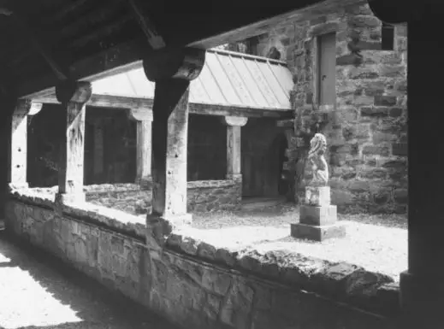

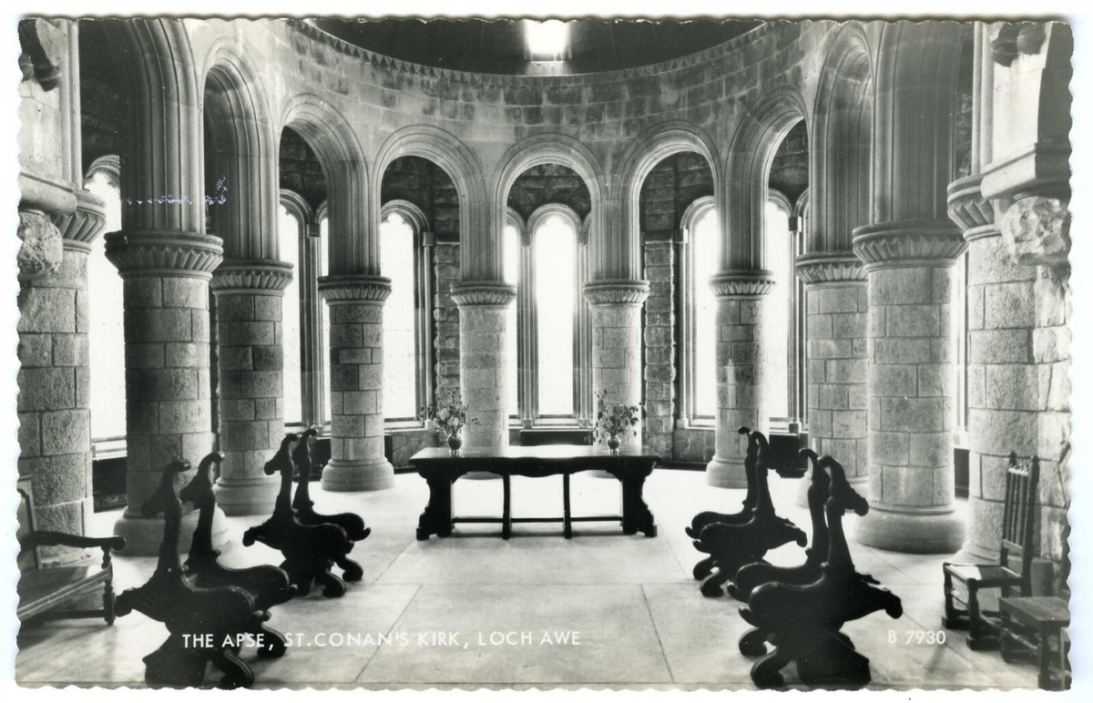
BUILDING THE KIRK
To build St Conan’s Kirk, thousands of tons of stone was needed.
This had to be transported to the construction site.
Different types of transport were used to move the stone.

Slide 3
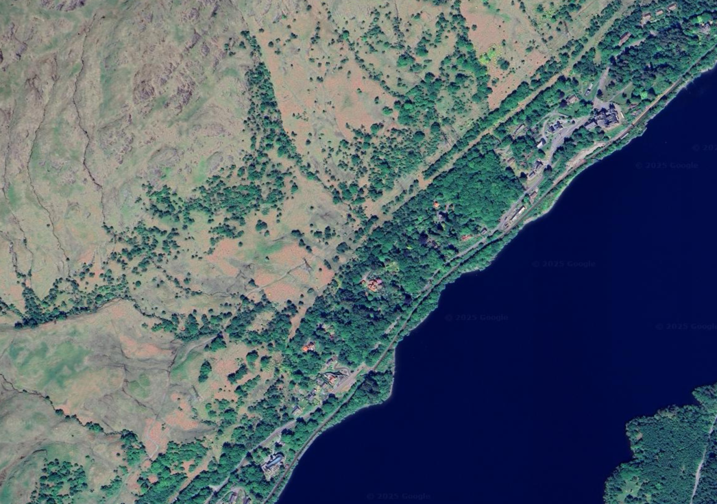
TRAINS
Trains were used to move the heavy stone and bring it into Lochawe Station.
The station is less than 1 mile from St Conan’s and was built in 1880.
Work started on St Conan’s a year later.
Lochawe Station
St Conan’s Kirk

Slide 4
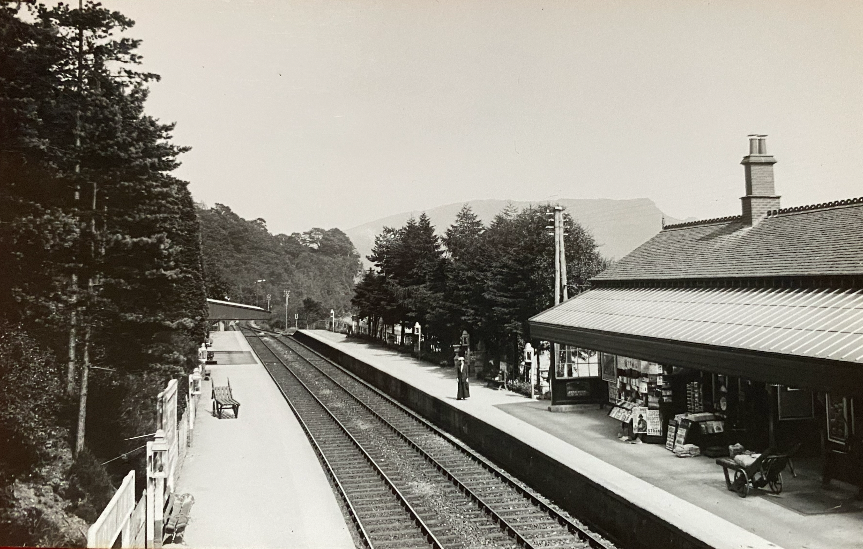
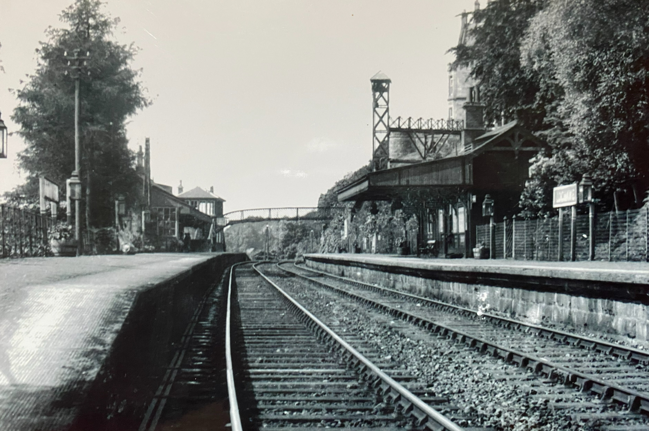
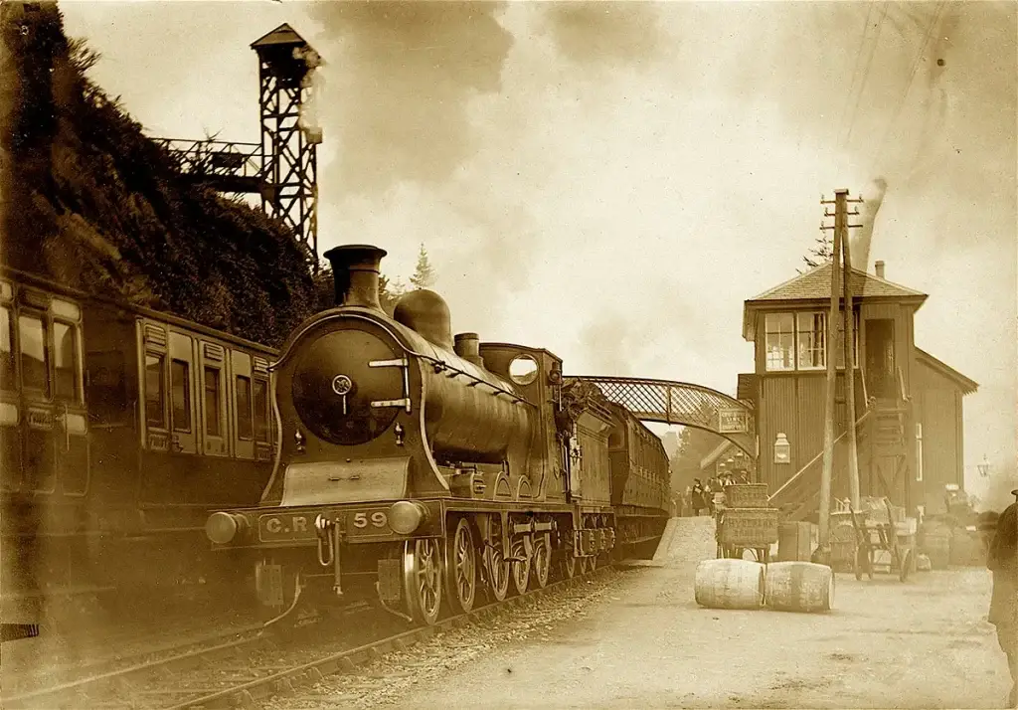
TRAINS
Lochawe Station.
Much bigger than it is today

Slide 5
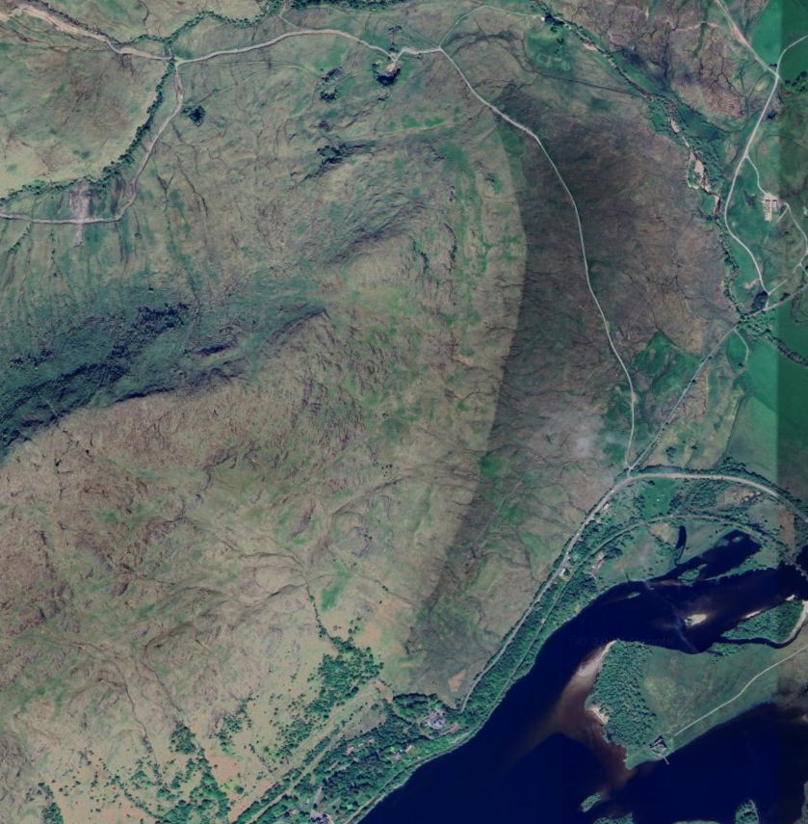

TRAINS
The stone was taken from the Ben Cruachan Mountain.
Somehow it had to be moved to Lochawe.
Ben Cruachan Stone Quarry
Lochawe Station

Slide 6

TRAINS
The stone was taken from the Ben Cruachan Mountain.
Somehow it had to be moved to Lochawe.
A new “Branch” line was built from the quarry to join the existing railway line.
Ben Cruachan Stone Quarry
Lochawe Station

Slide 7

TRAINS
The mountain is very steep, and the trains couldn’t get to the quarry using a normal railway line.
To get the stone down from the mountain a special zig-zag railway line was built.
This allowed the train to climb up and down the mountain, bringing the stone to Lochawe station.

Slide 8
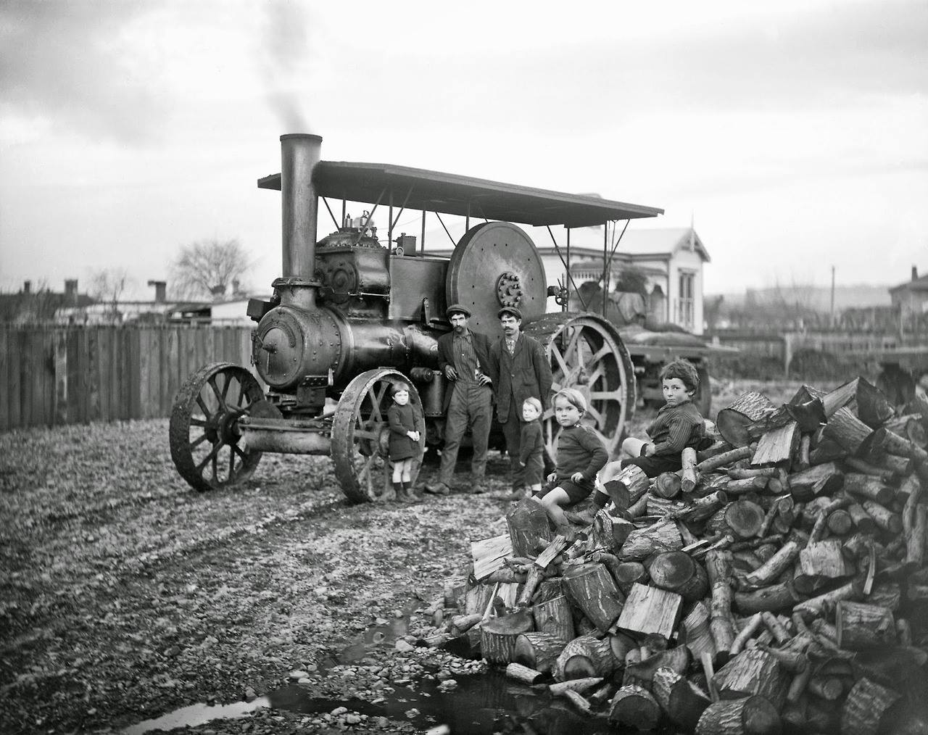
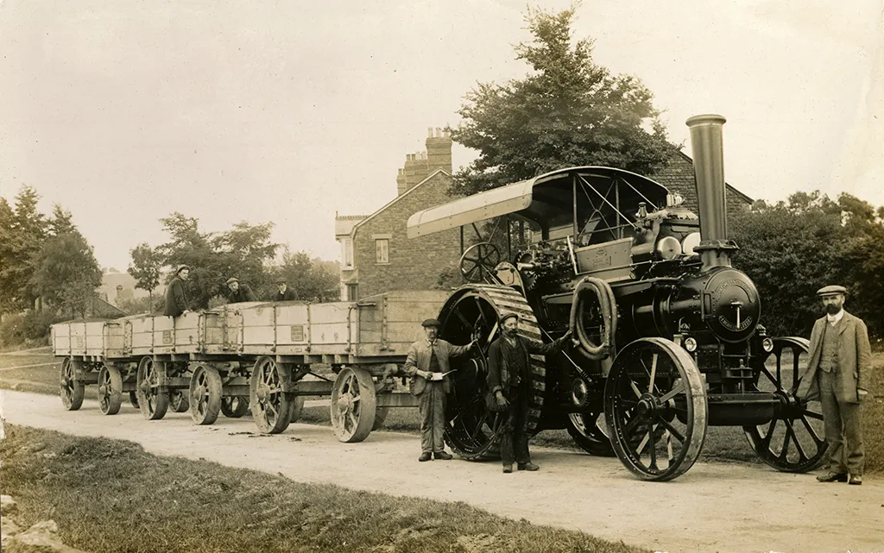
TRACTION ENGINES
To move the stone from the Railway station to St Conan’s Kirk, old machines called “Traction Engines” were used.
Long “road trains” would be loaded with the stone and trundled the 1 mile from the station.
These turned into what we now call Tractors.

