Slide 1

FACES AT THE KIRK

Slide 2

FACES AT THE KIRK
Both inside and out, St Conan’s Kirk is full of faces made from stone, glass and wood. Here is a selection of some of our favourite faces and the location of them in the Kirk.

Slide 3
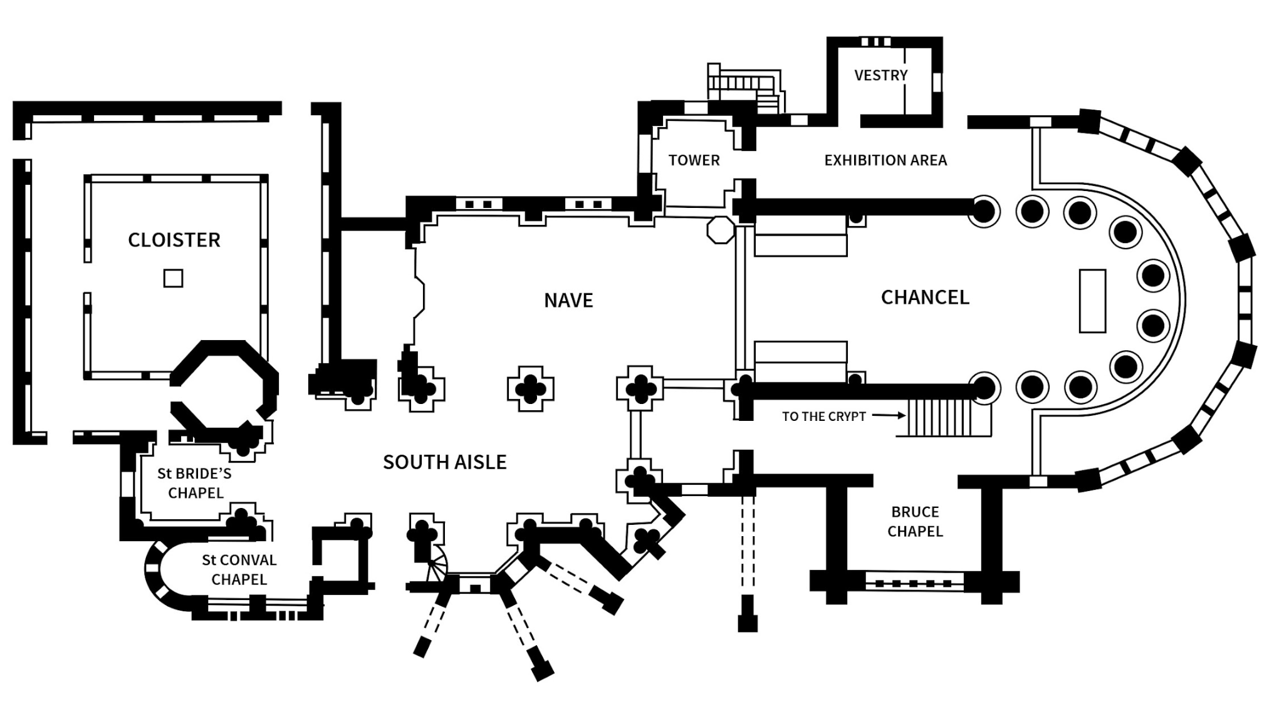
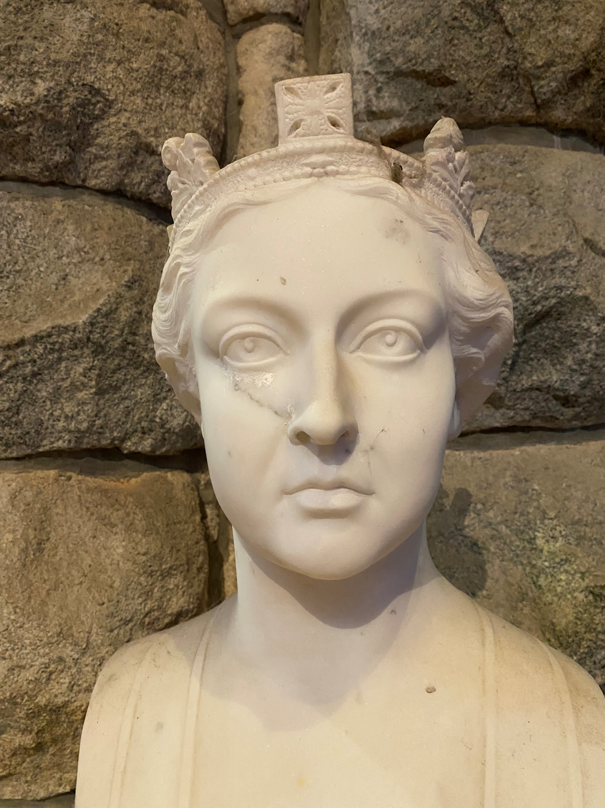
VICTORIA

Slide 4
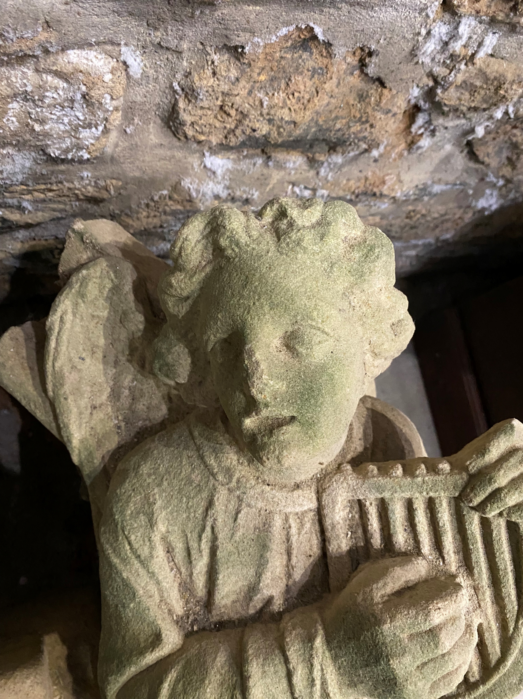
ANGEL PLAYING THE HARP

Slide 5
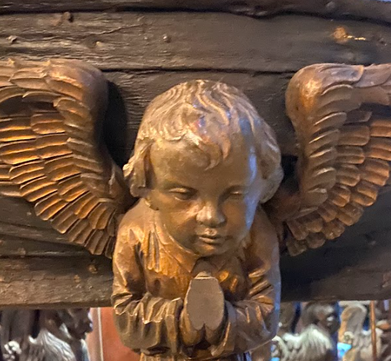
CHERUB ON THE FONT

Slide 6
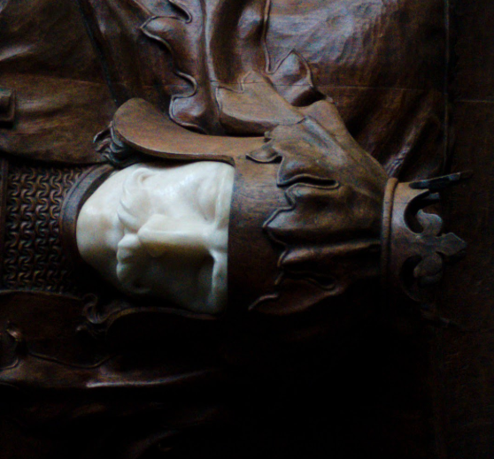
KING ROBERT THE BRUCE

Slide 7
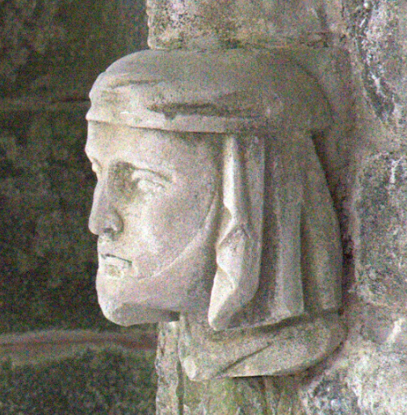
THE DOORKEEPER

Slide 8
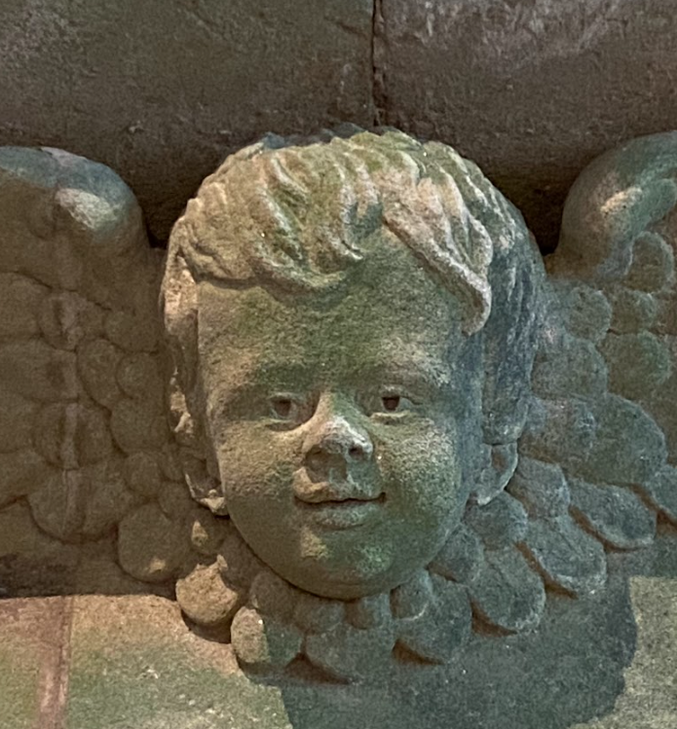
CHEEKY CHERUB – ONE OF EIGHT

Slide 9
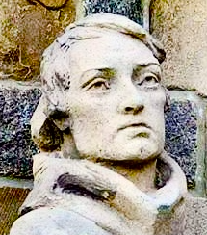
ST CONAN HIMSELF

Slide 10
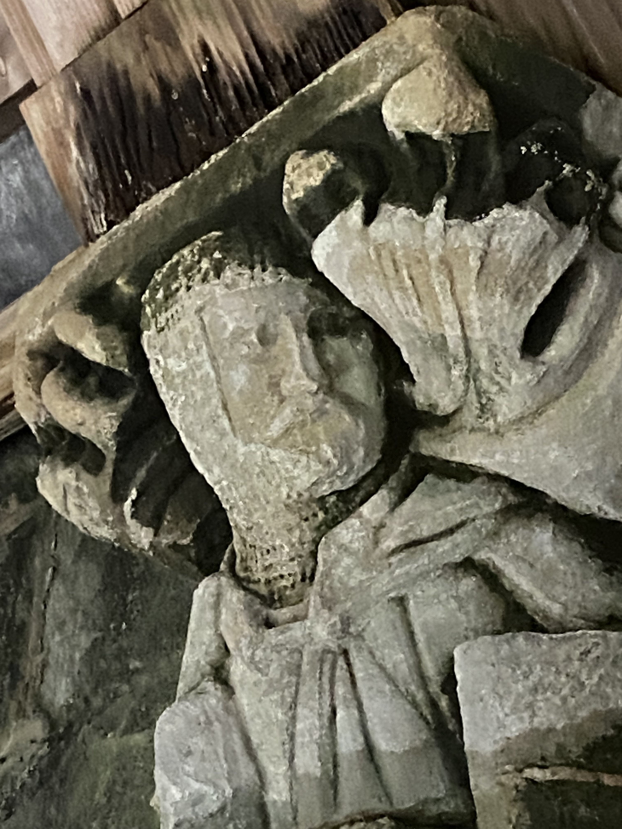
THE PILGRIM KNIGHT

Slide 11
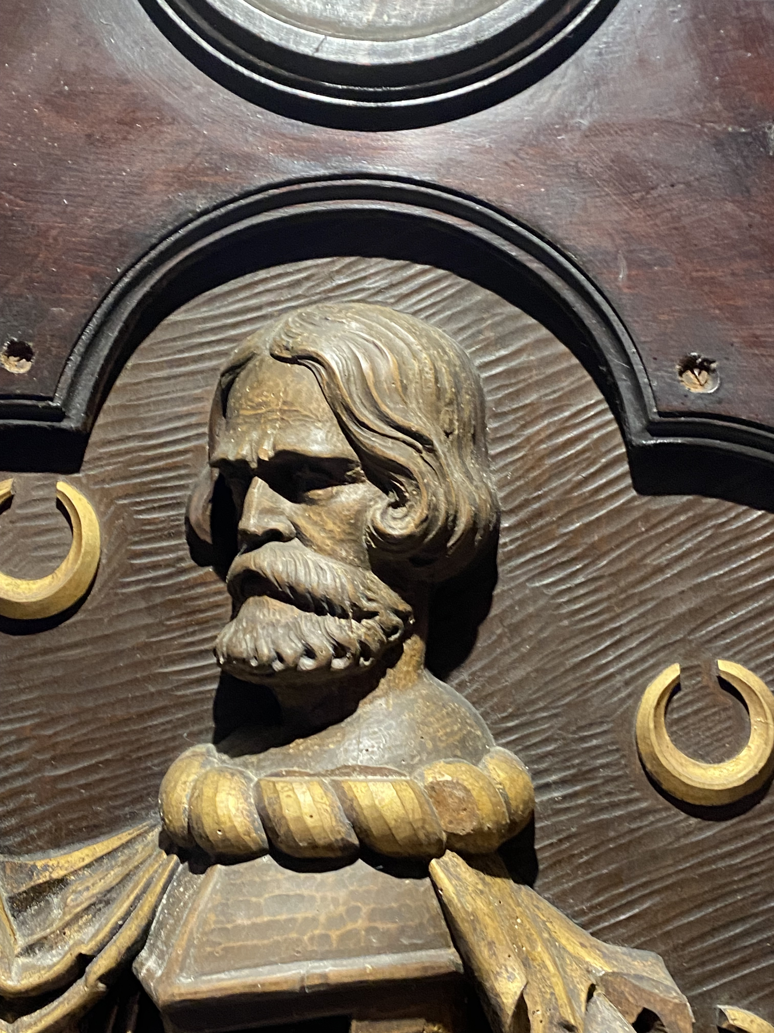
CLAN MCNAB

Slide 12
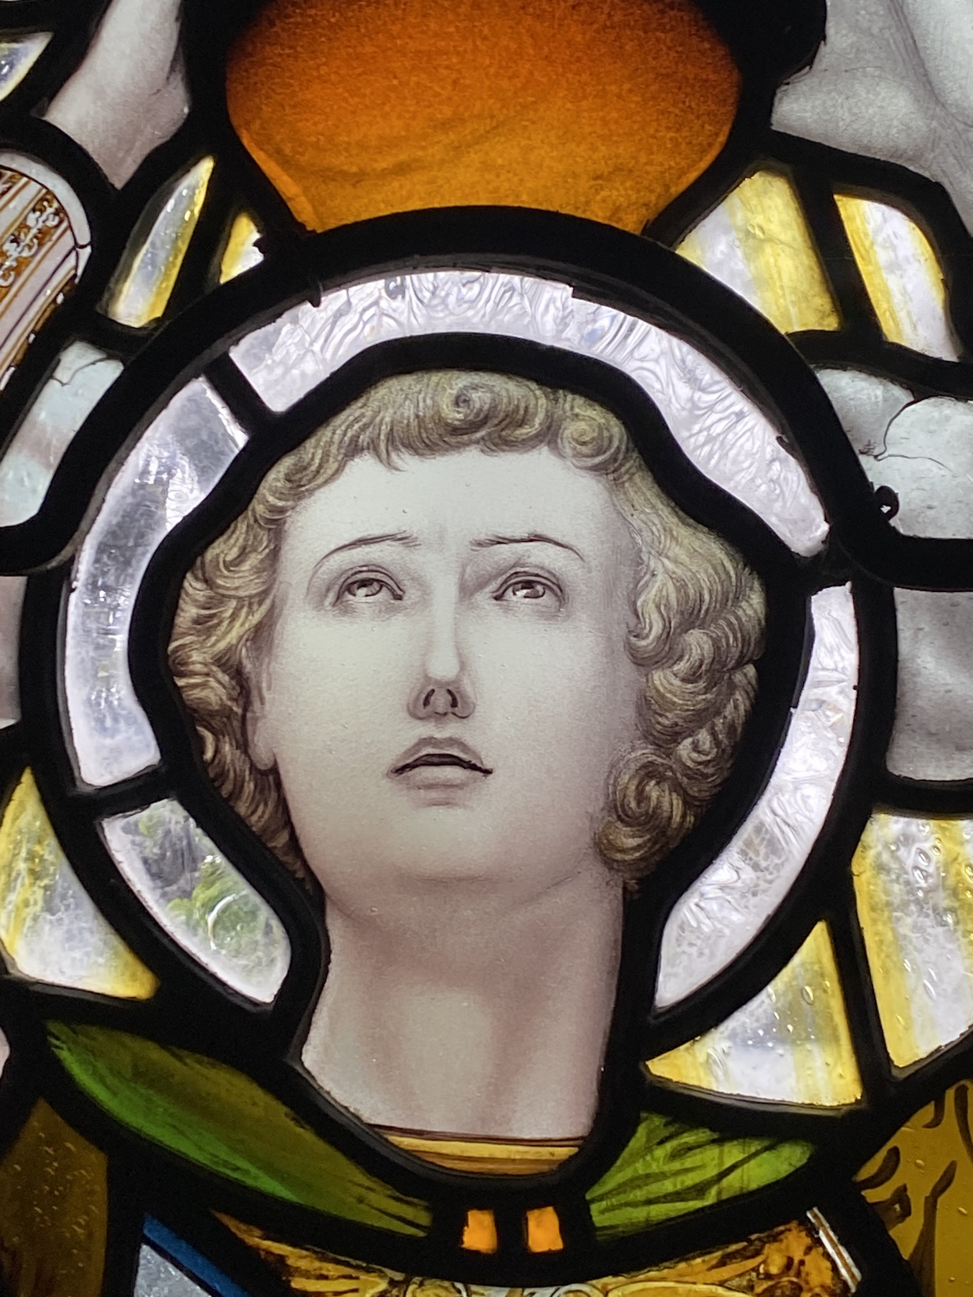
WARRIOR OF CHRIST

Slide 13
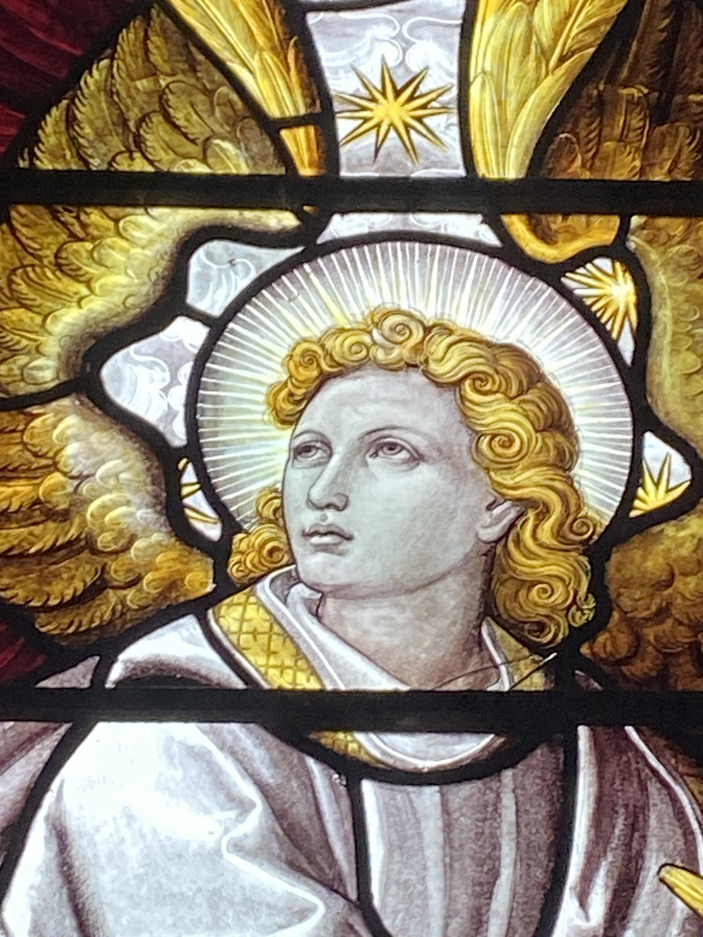
THE ANGEL GABRIEL

Slide 14
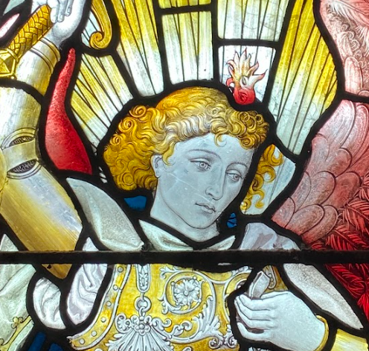
ST MICHAEL

Slide 15
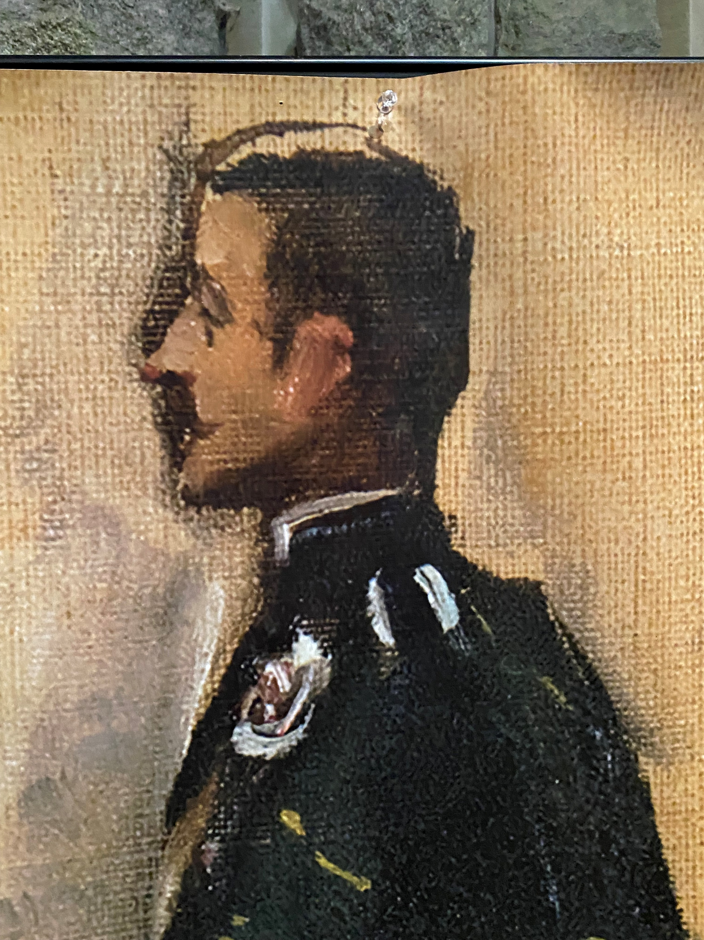
WALTER DOUGLAS CAMPBELL

Slide 16
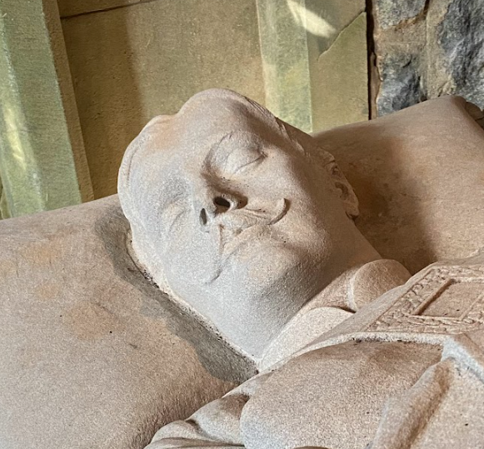
WALTER DOUGLAS CAMPBELL

Slide 17
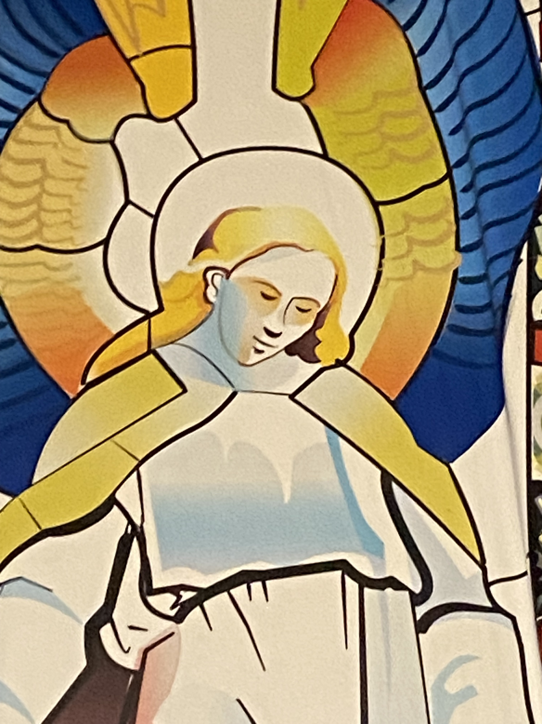
JESUS CHRIST

Slide 18
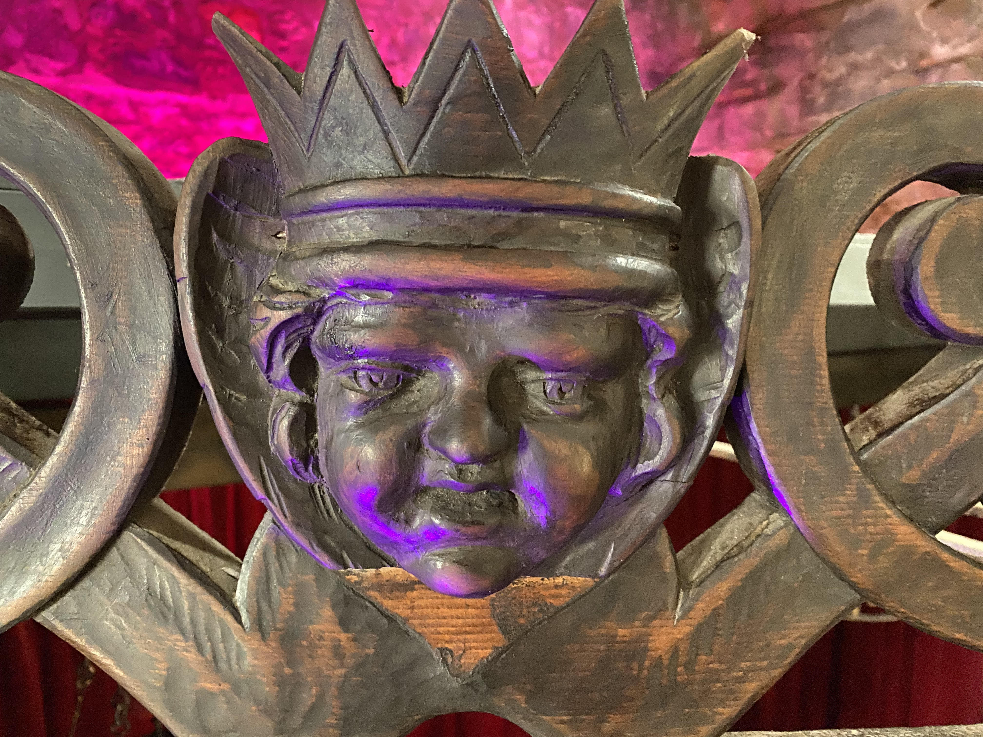
THE ORGAN SCREEN

Slide 19
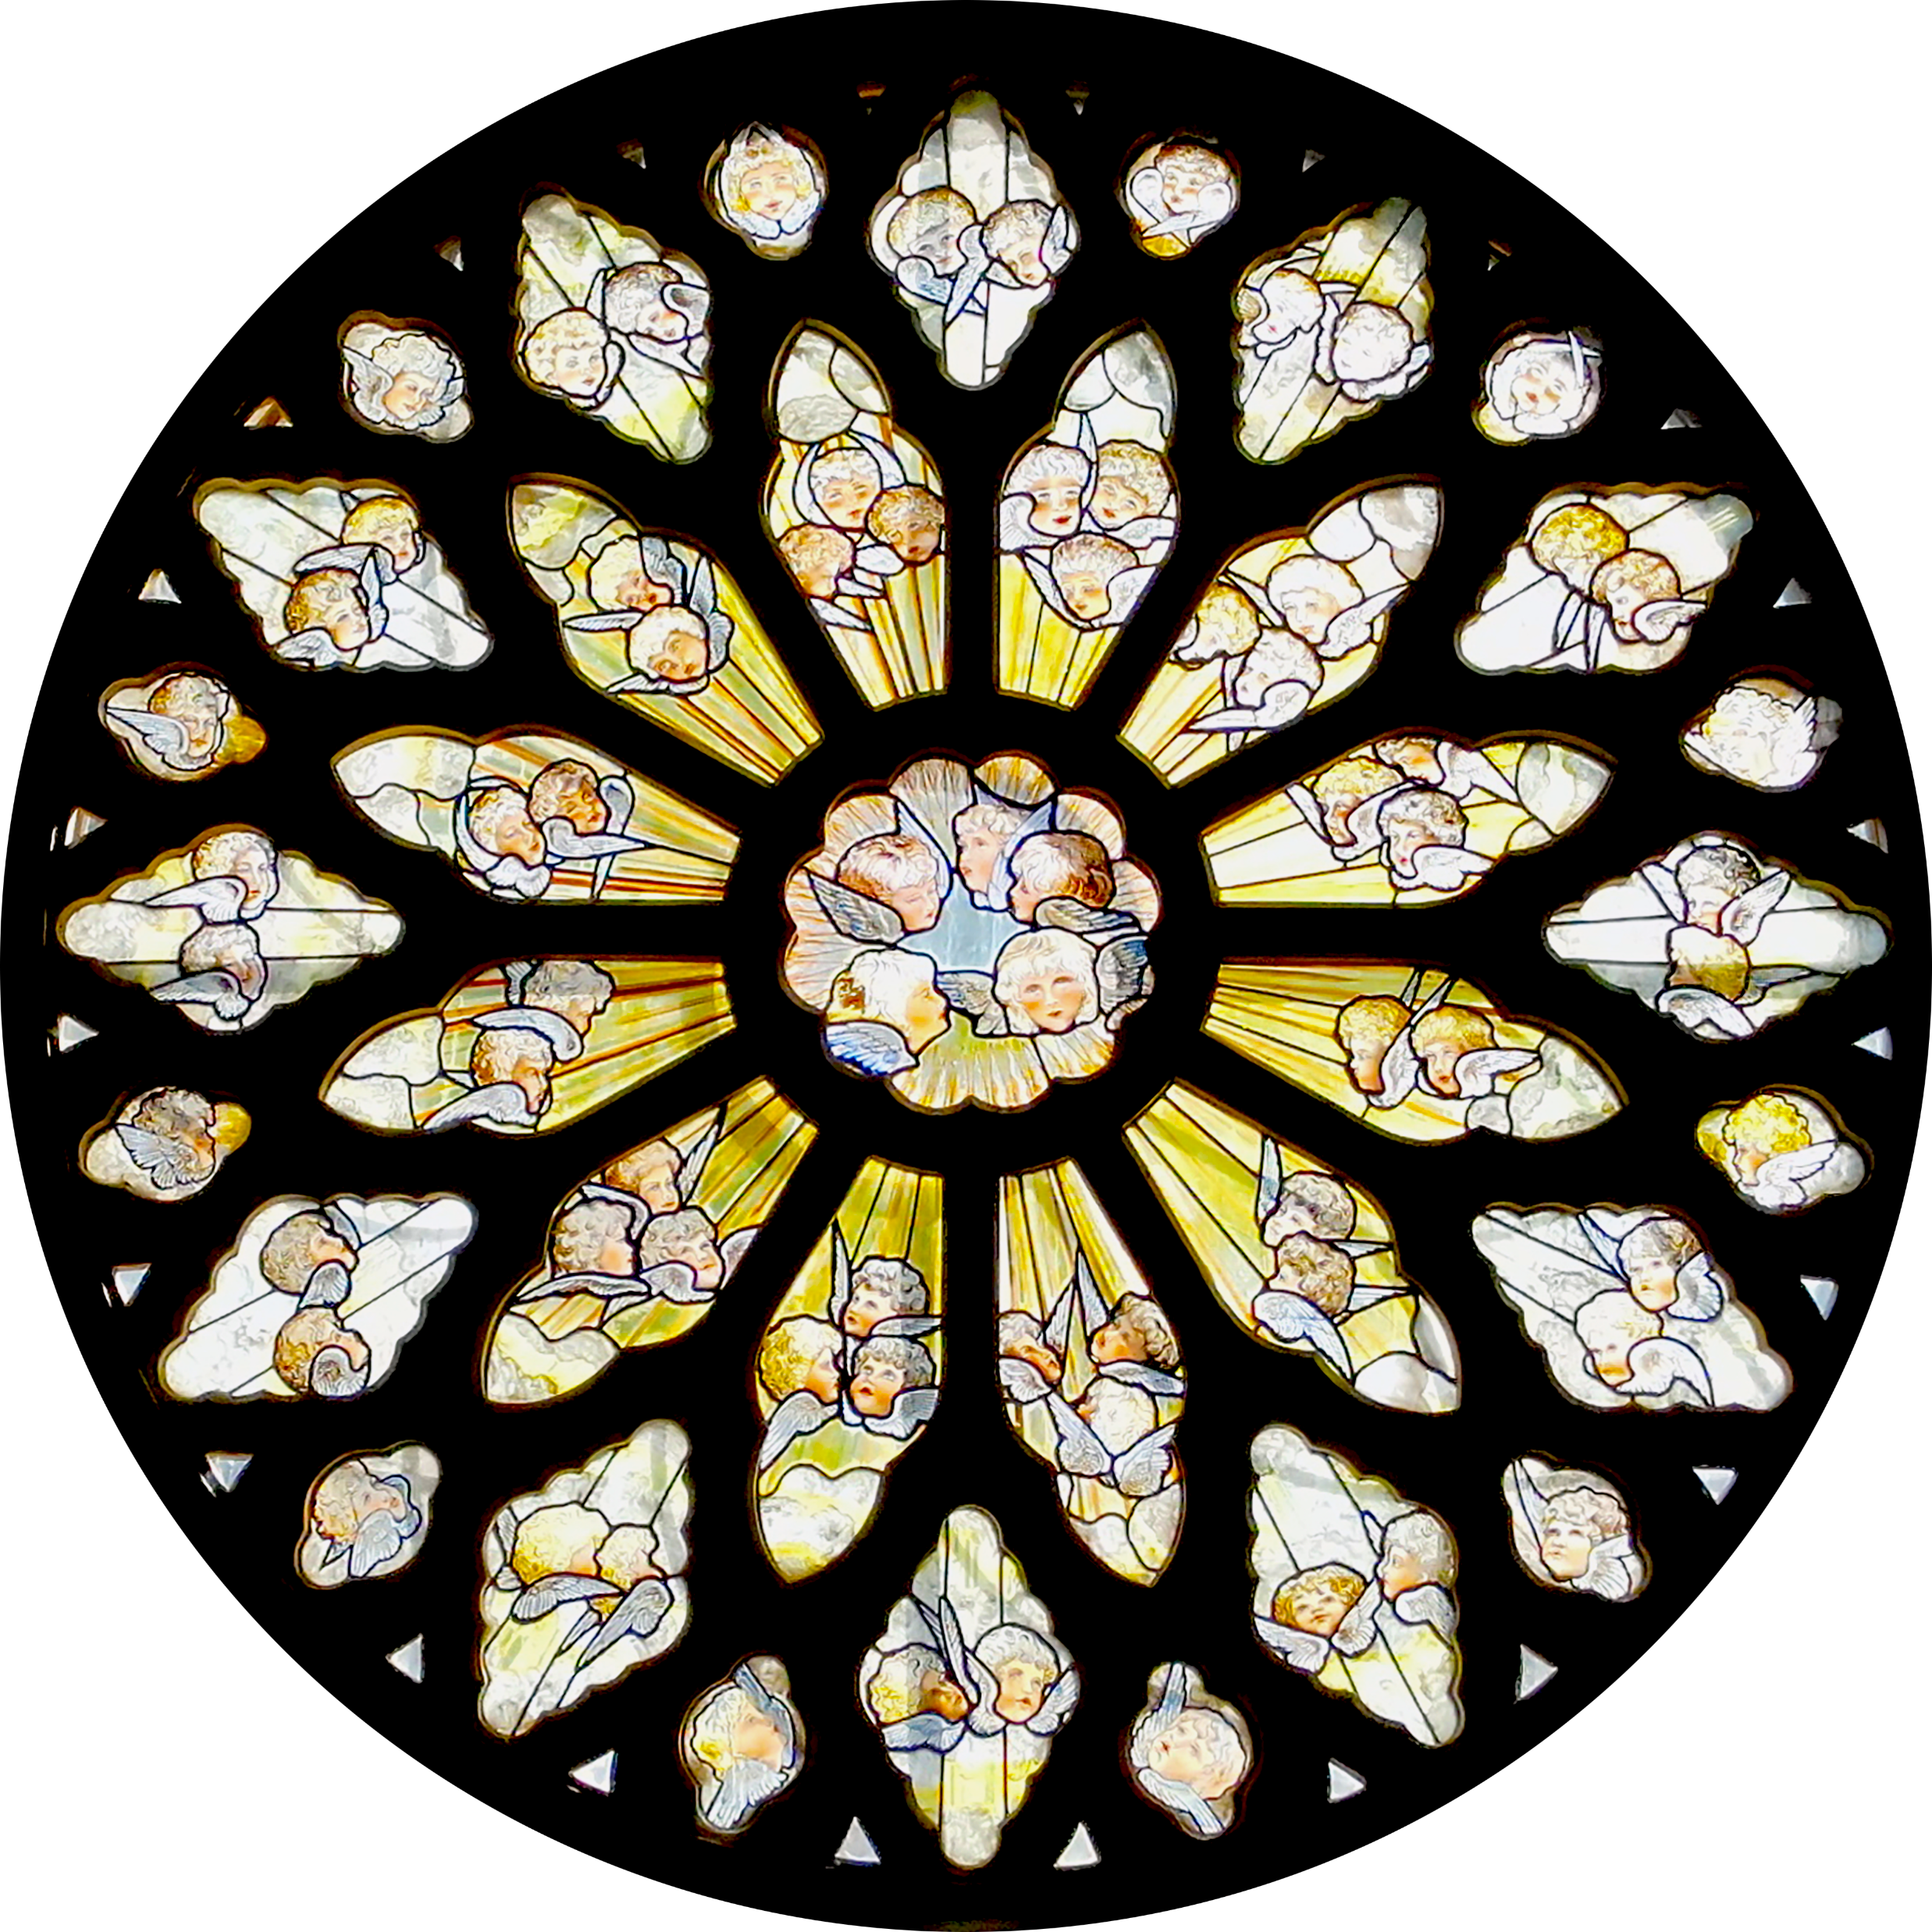
THE ROSE WINDOW

